Slide 1
Automating common
Internet tasks
Section 9
Notes:
[Mandatory Slide] This would be the introduction slide of the topic that you are covering in this section.
When this slide plays, you could talk about the main aim that we’d be covering in this section.

Slide 2
What We’ll Learn
Reading and sending emails with Gmail
Backing up on Dropbox your local data folders with Dropbox client
Tracking all of your personal notes using the Evernote API
Using Firebase Cloud Messaging to send a push notification to your Android apps with with PyFCM
Watching for topics on the Python Reddit RSS feed
Sending a text SMS via Twilio with Twilio client
Tweeting a positive message to the world with Twithon

Slide 3
Reading and sending emails with Gmail
Notes:
[Mandatory Slide] This would be the introduction slide of the topic that you are covering in this subsection.
When this slide plays, you could talk about the main aim that we’d be covering in this video.

Slide 4
In this Video, we are going to take a look at…
Setup your Gmail account
Setup Gmail Sender
Code sample
Notes:
[Mandatory Slide]
Before the start of the video, we’d like to highlight what are important topics or pointers that we’d be covering in this video. This slide would immediately follow the intro/name slide. This would just be say 2-3 points for the viewers to know what they are getting into.

Slide 5
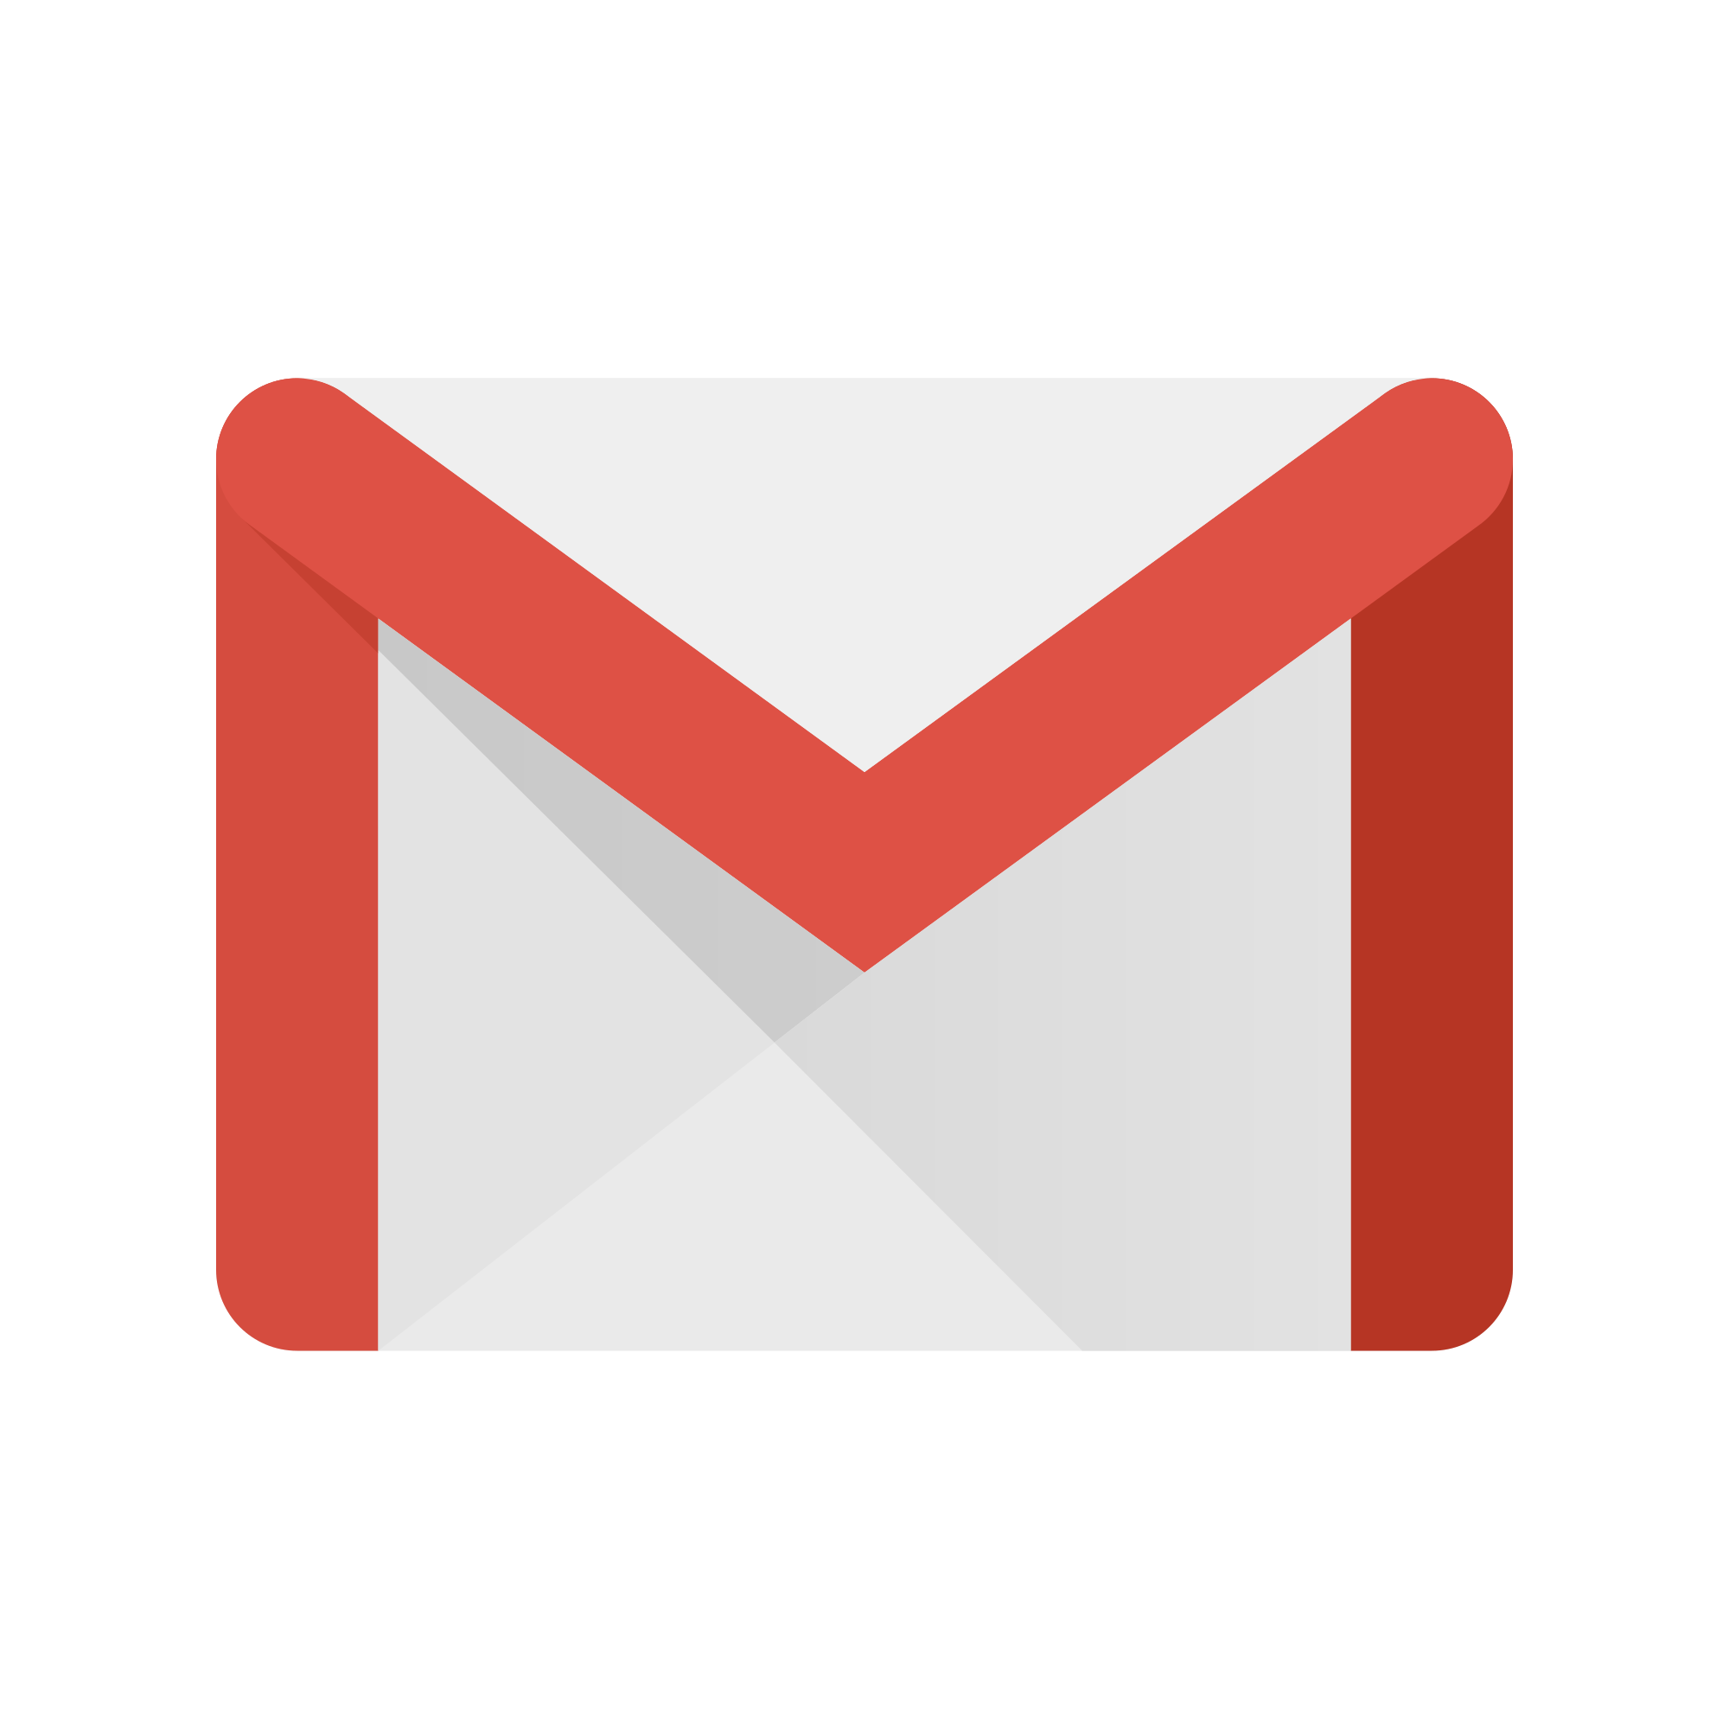
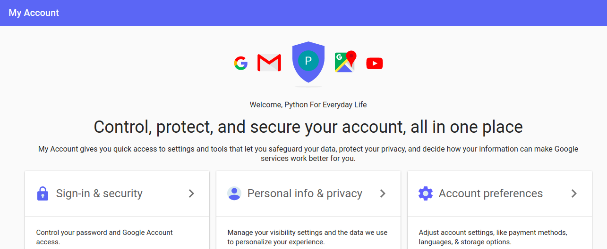
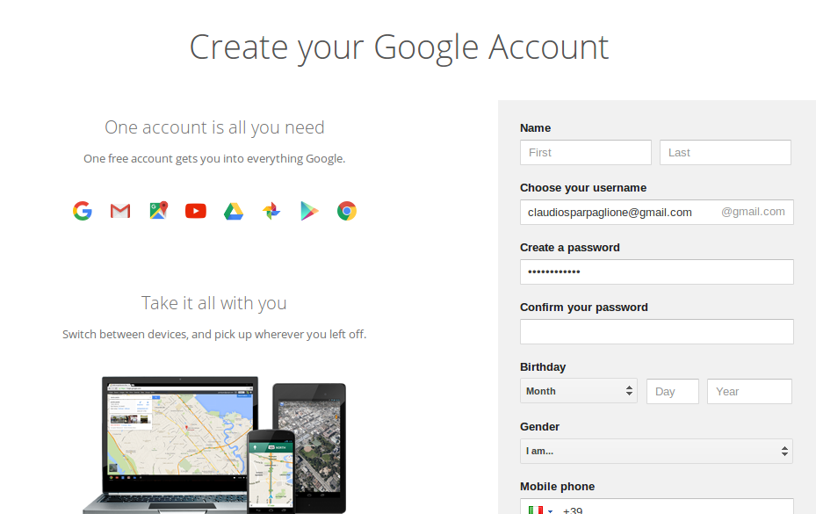

Setup your Gmail account (1/2)
If you don’t already have one, open up a new Google account at http://mail.google.com (take note of your address and password)
Go to https://myaccount.google.com, select “Sign-in & Security”, then switch “Allow less secure apps” on
Notes:
[Mandatory Slide]
Before the start of the video, we’d like to highlight what are important topics or pointers that we’d be covering in this video. This slide would immediately follow the intro/name slide. This would just be say 2-3 points for the viewers to know what they are getting into.

Slide 6

Setup your Gmail account (2/2)
Wait, wait! Switching on less secure apps grant is the quickest way to allow your Python code to access your Google account programmatically - though also the less secure
You should instead create a per-app access token (eg. using OpenAuth2 protocol support) and assign it to your Python code
Notes:
[Mandatory Slide]
Before the start of the video, we’d like to highlight what are important topics or pointers that we’d be covering in this video. This slide would immediately follow the intro/name slide. This would just be say 2-3 points for the viewers to know what they are getting into.

Slide 7
Setup Gmail Sender
We will use Gmail Sender to send emails with Gmail. Install it with: pip install gmail
We will read emails using the IMAP protocol and the Python Standard Library
IMAP is a complex but very spread protocol for retrieving e-mails from mail servers. Along with POP is the de-facto protocol for mailboxes programmatic management
Notes:
[Mandatory Slide]
Before the start of the video, we’d like to highlight what are important topics or pointers that we’d be covering in this video. This slide would immediately follow the intro/name slide. This would just be say 2-3 points for the viewers to know what they are getting into.

Slide 8
Code sample
Notes:
Something that needs to grab the viewers attention!!

Slide 9
Summary
Setup your Gmail account
Setup Gmail Sender
Code sample
Notes:
[Mandatory Slide]
Before the start of the video, we’d like to highlight what are important topics or pointers that we’d be covering in this video. This slide would immediately follow the intro/name slide. This would just be say 2-3 points for the viewers to know what they are getting into.

Slide 10
Tweeting a positive message to the world with Twithon
Next Video
Notes:
[Mandatory Slide]
Here the name of the next video needs to be mentioned. The narration as you guessed it would be just letting the viewer know exactly where we are at and what we’d be taking over next! ☺

